Slide 1

Provably Stable Feature Rankings with SHAP and LIME
Jeremy Goldwasser

Slide 2
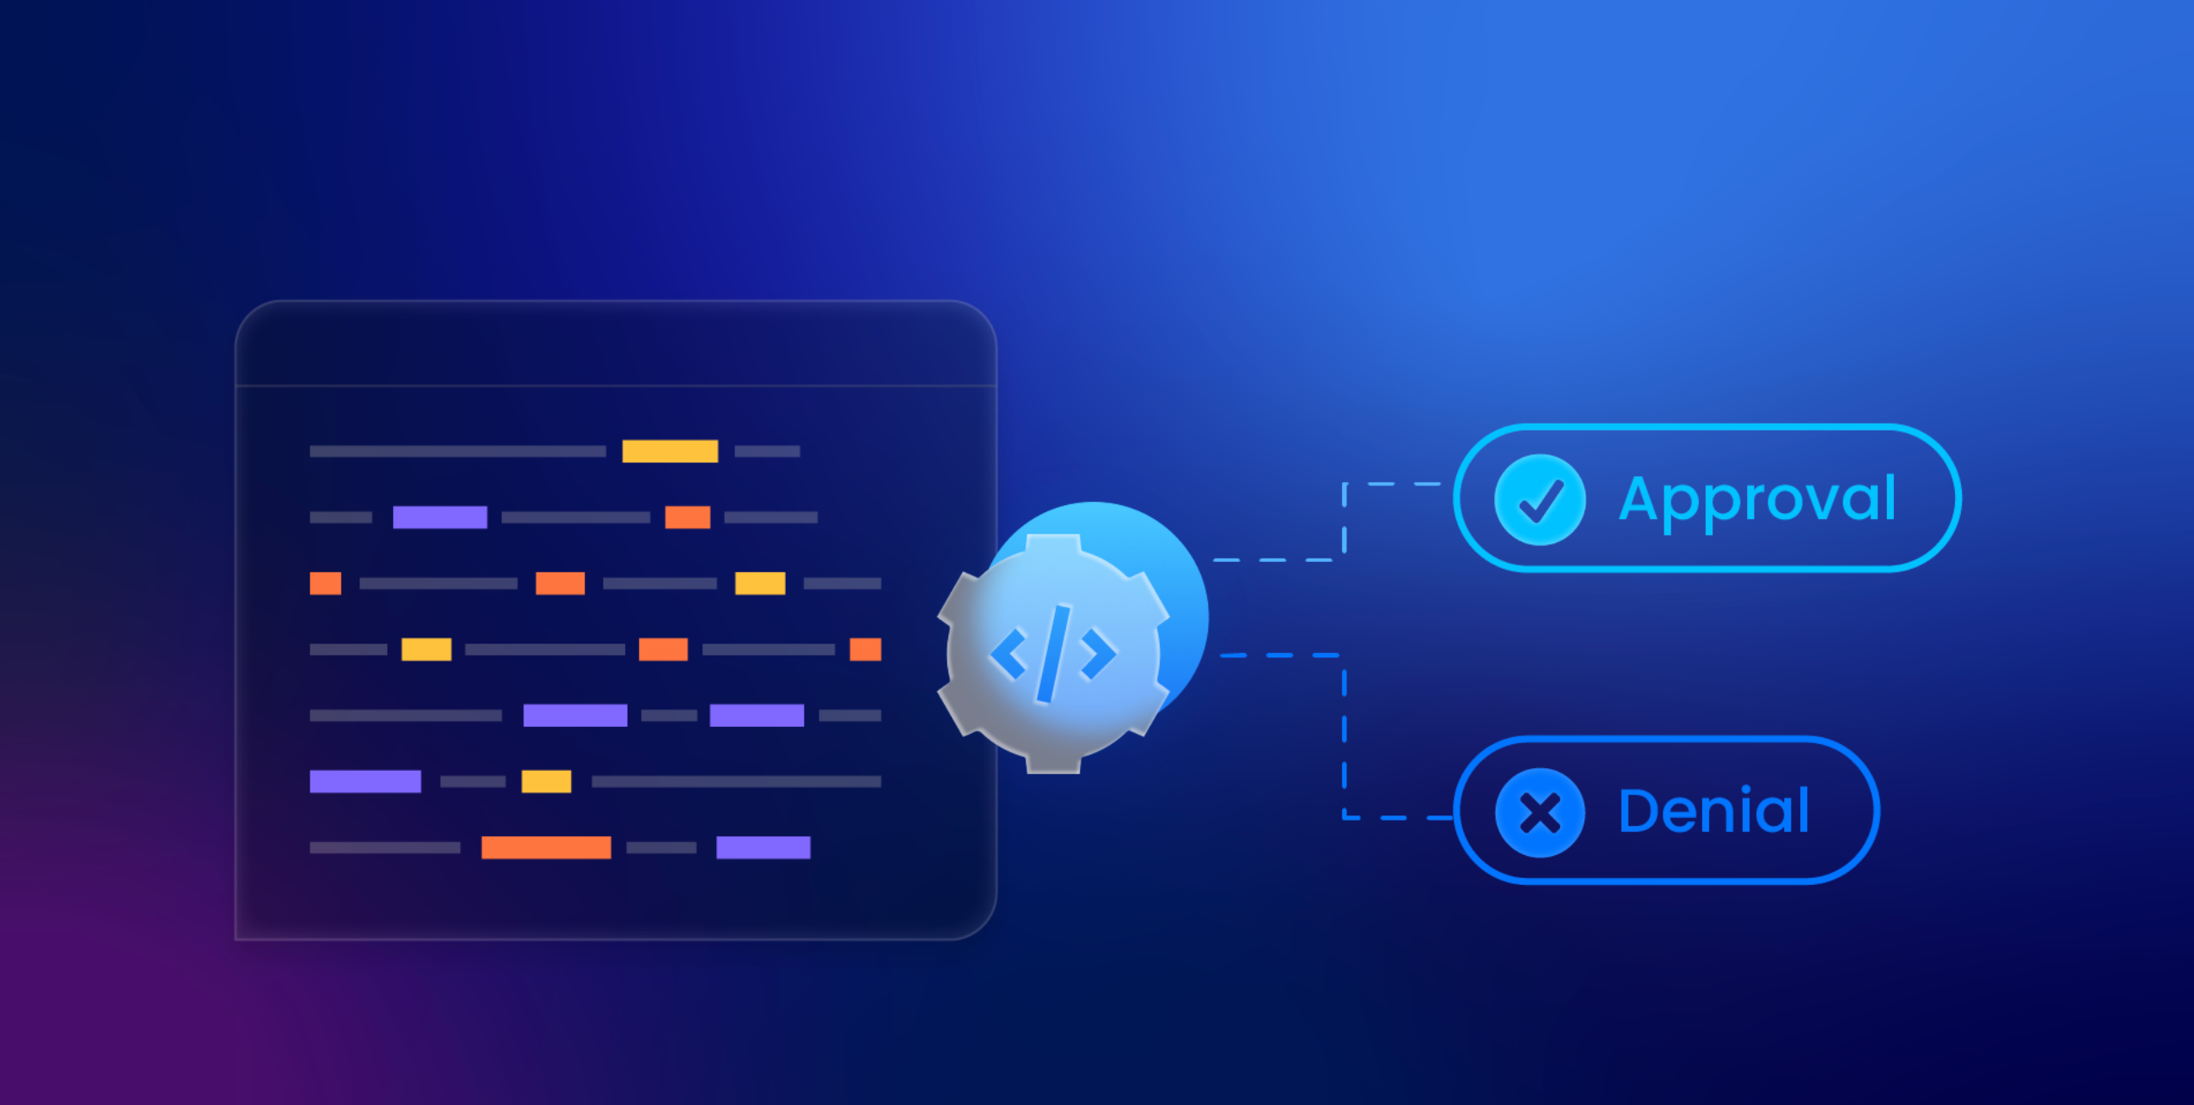
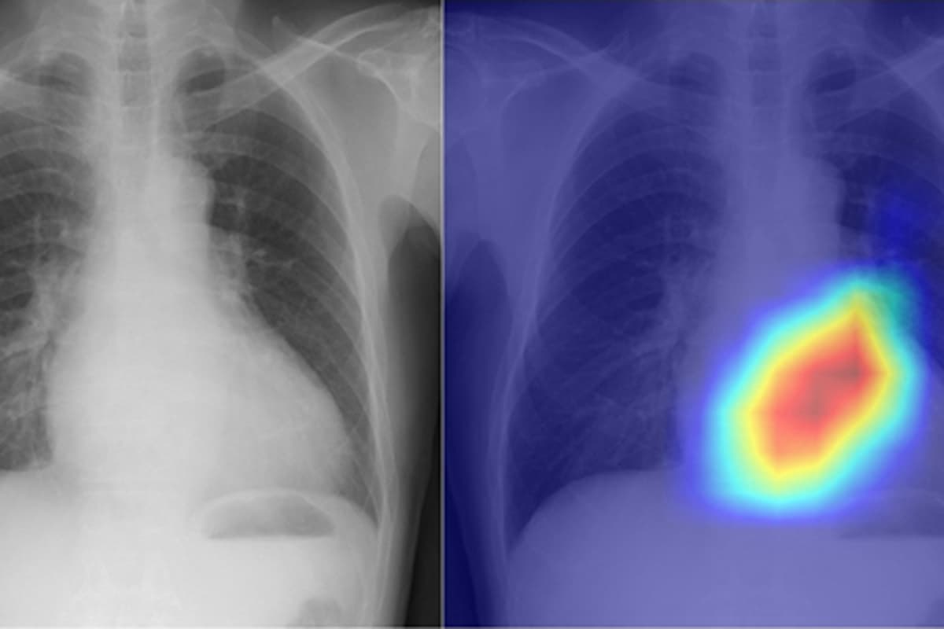
Why did the AI make this decision?

Slide 3

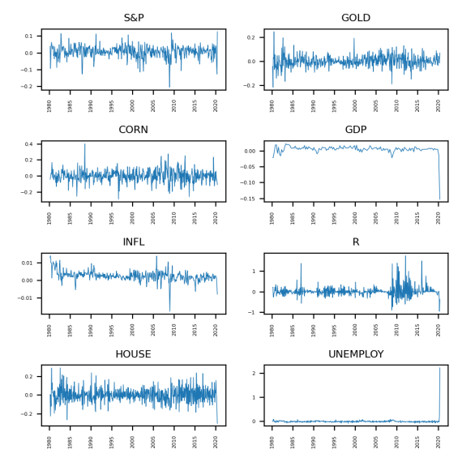
Learning from AI

Slide 4
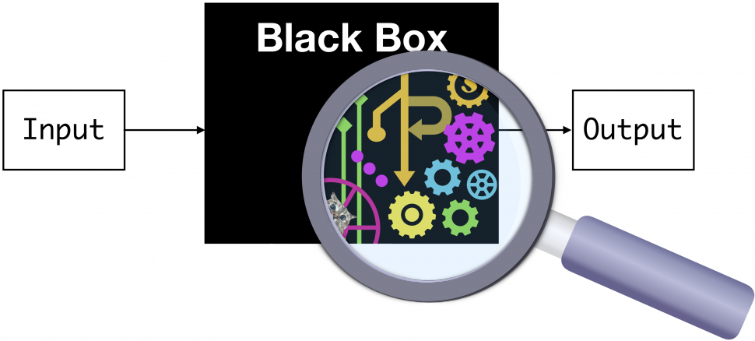
Local Explanations
Why did our model predict y on input x?

Slide 5
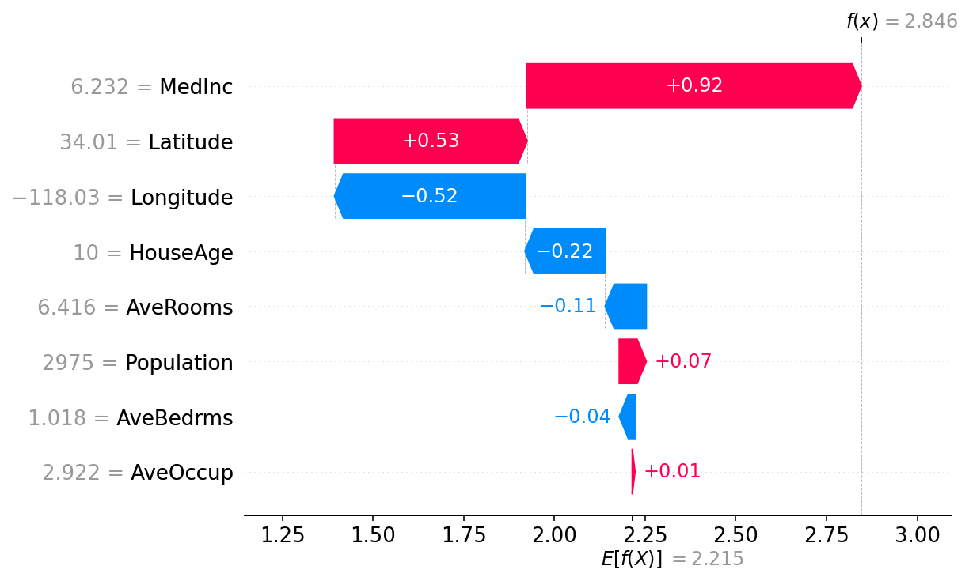
Feature Attributions

Slide 6
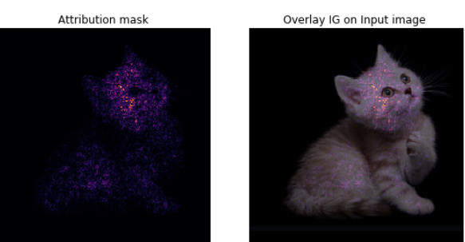
Gradient-Based Methods

Slide 7
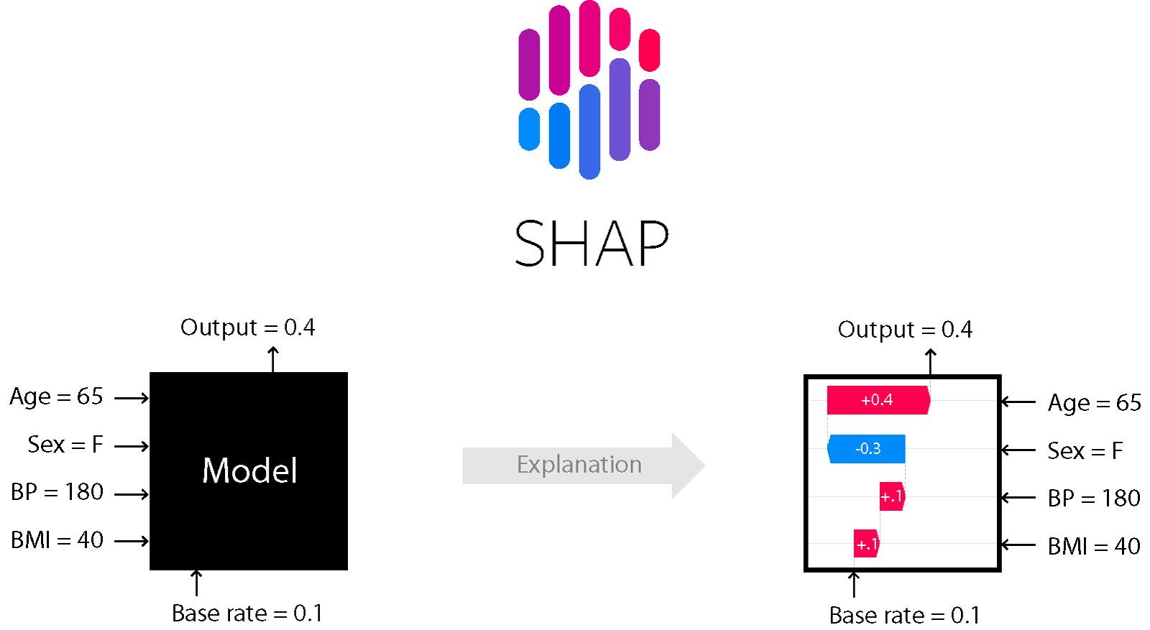

Slide 8
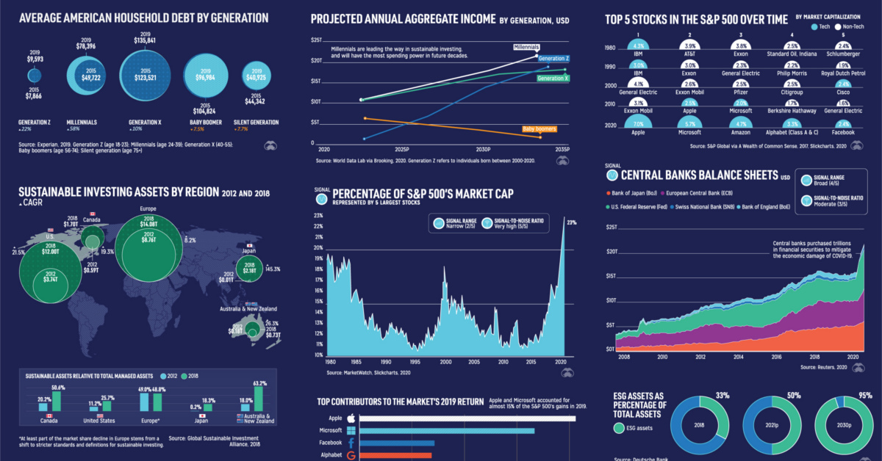
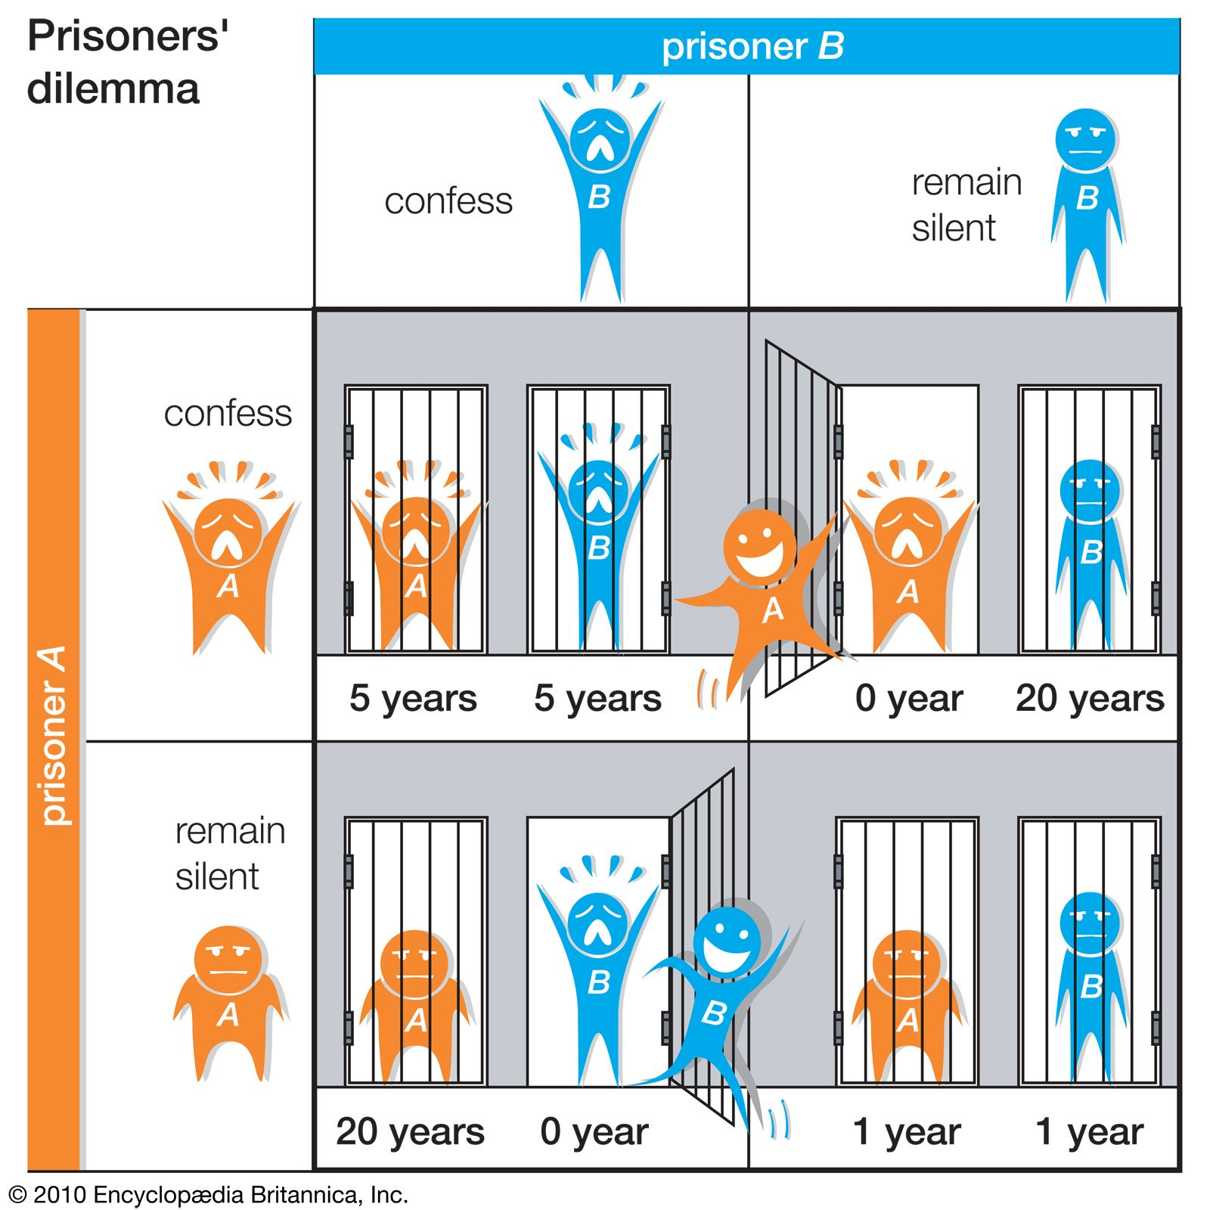



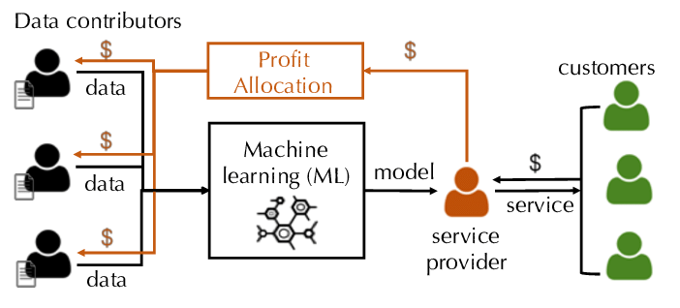
Shapley Values

Slide 9

A Two-Minute Introduction to Shapley Values

Slide 10

How valuable was LeBron James to the 2022-2023 Lakers?

Slide 11



Slide 12
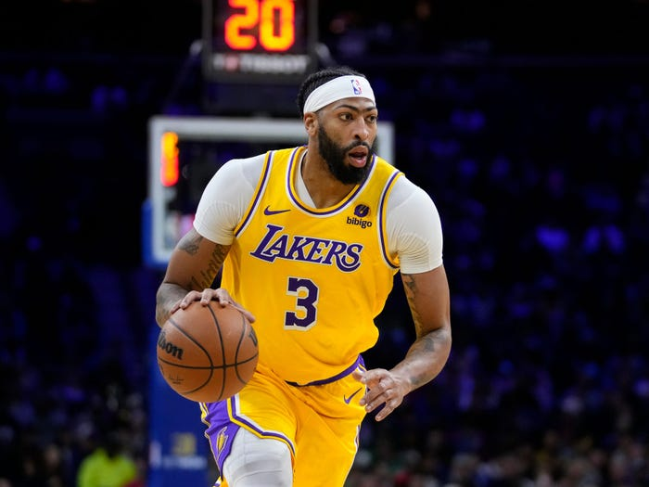


Slide 13



Slide 14


Slide 15
The Shapley Value
Intuition: A player’s value depends on their contribution to coalitions of their teammates
Basketball, evaluate team given players in S
SHAP, evaluate prediction given features in S

Slide 16
The Shapley Value
Intuition: A player’s value depends on their contribution to coalitions of their teammates
Basketball, evaluate team given players in S
SHAP, evaluate prediction given features in S:

Slide 17

Shapley Axioms
SHAP uniquely satisfies 3 desiderata for ML feature explanations:
Local Accuracy. Sum of importance scores is prediction
Missingness. Missing feature → score is 0
Consistency. Consider 2 models, A and B. If knowing a feature changes the prediction more on model A, then its score on A is at least as big as on B.

Slide 18
Shapley Estimation
terms may be computationally prohibitive
→ Use sampling-based approximation

Slide 19
Shapley Estimation
Shapley Value
SHAP value function
Shapley Sampling Estimate

Slide 20
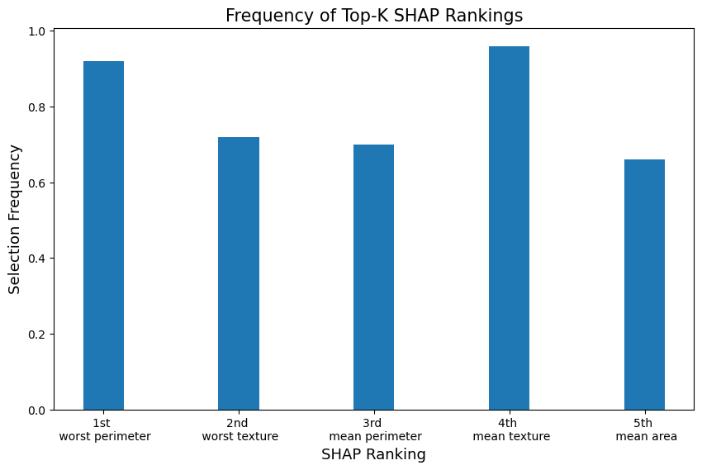
Instability with SHAP

Slide 21
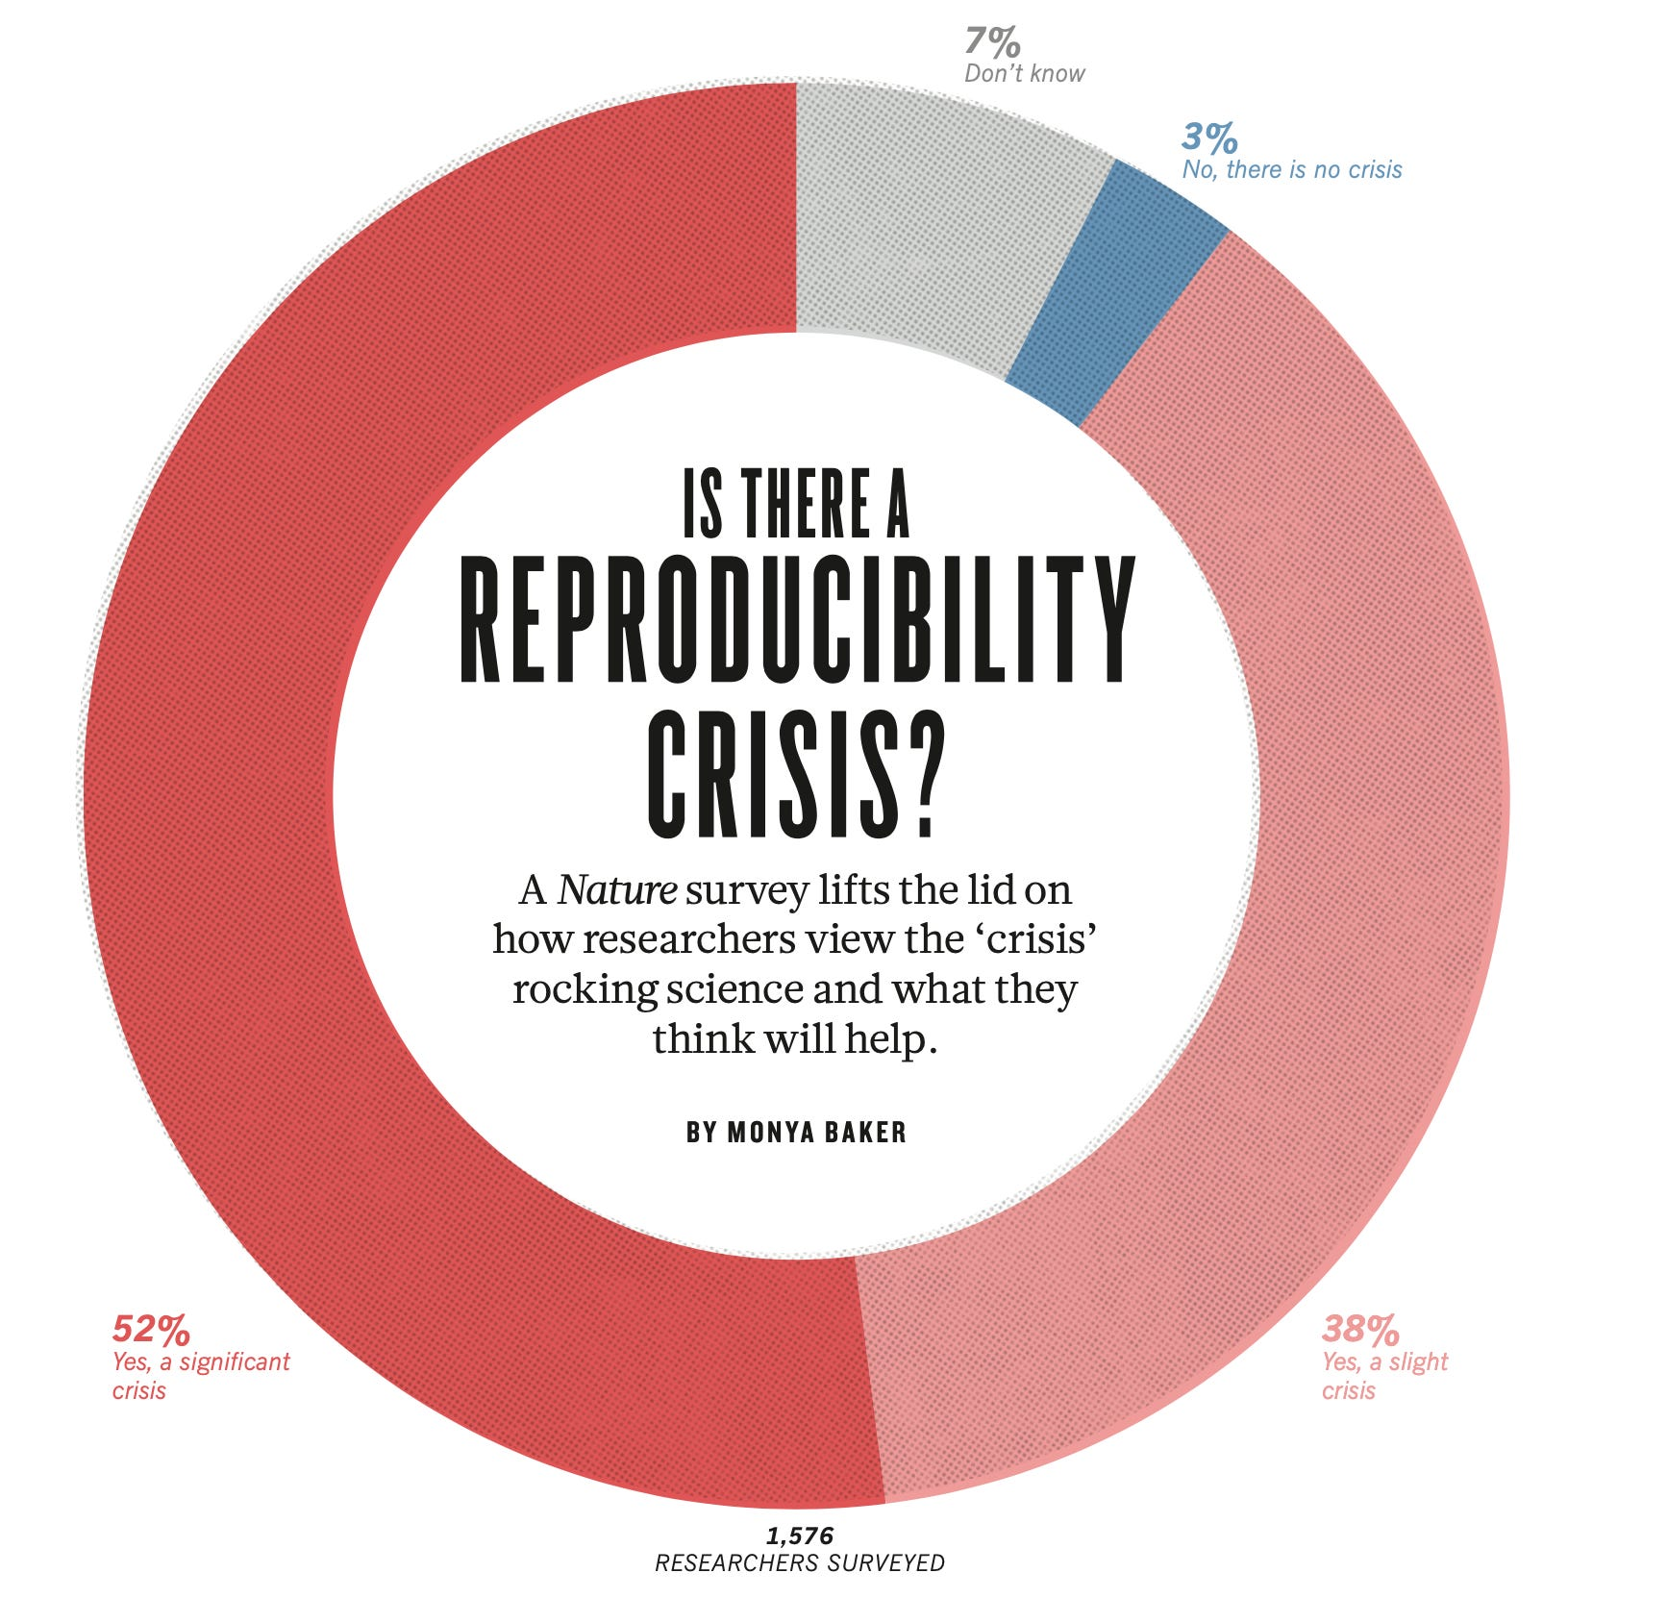
“Stability is a common-sense principle and a prerequisite for knowledge. It is related to the notion of scientific reproducibility, which Fisher and Popper argued is a necessary condition for establishing scientific results.
Bin Yu and Karl Kumbier, Veridical Data Science, (PNAS, 2020)

Slide 22
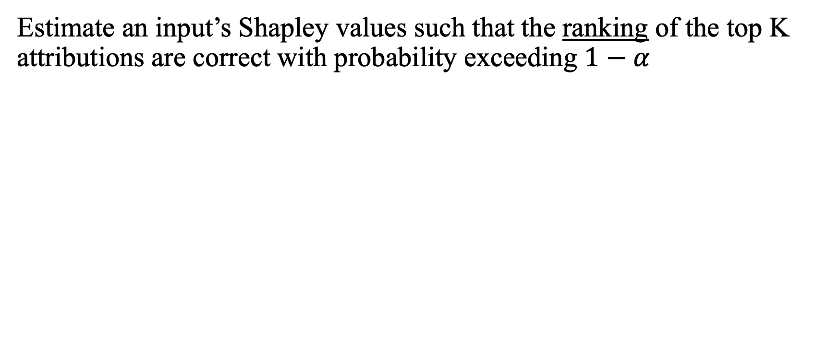
Desideratum
Estimate an input’s Shapley values such that the ranking of the top K attributions are correct with probability exceeding $1−α$
w$here \left(\hat{1}\right), \left(\hat{2}\right), …$ denotes the index of the 1st, 2nd, … estimated Shapley value.
e.g. Want to confirm 2 most important features ⬄ Confirm 1st beats 2nd, & 2nd beats 3rd.

Slide 23
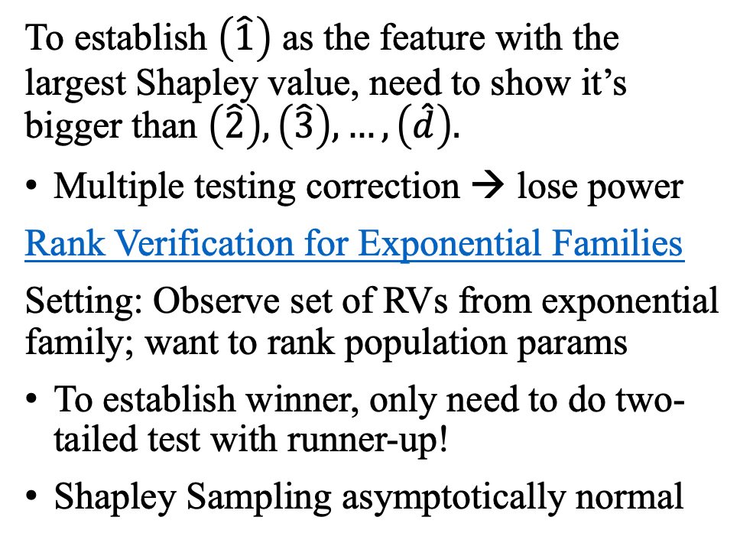
Largest Shapley Value
To establish $\left(\hat{1}\right)$ as the feature with the largest Shapley value, need to show it’s bigger than $\left(\hat{2}\right),\left(\hat{3}\right), …,\left(\hat{d}\right).$
Multiple testing correction → lose power
Rank Verification for Exponential Families
Setting: Observe set of RVs from exponential family; want to rank population params
To establish winner, only need to do two-tailed test with runner-up!
Shapley Sampling asymptotically normal

Slide 24
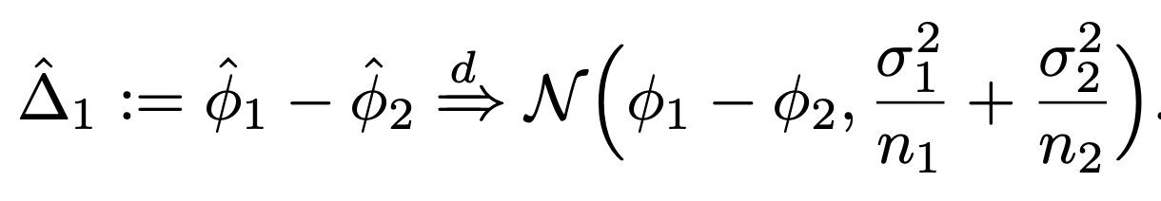
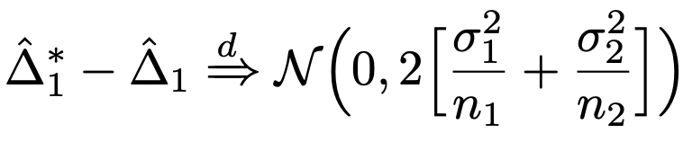
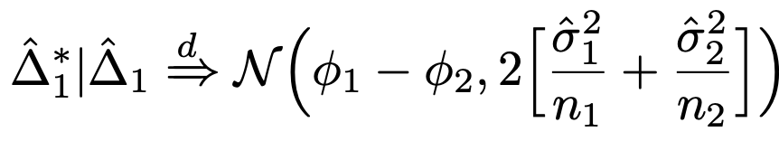
Testing 1st vs 2nd place
Want resampled Shapley estimates to have same order
Shapley estimates converge to Gaussian

Slide 25
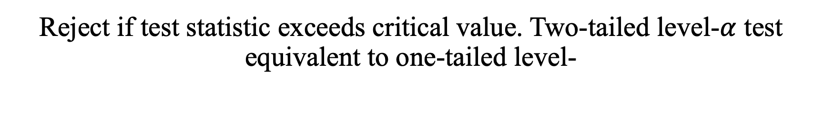
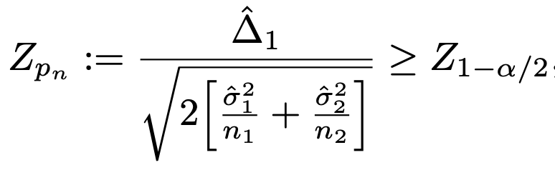
Testing 1st vs 2nd place
Obtain P(resampled order different) by integrating over normal tails
Reject if test statistic exceeds critical value. Two-tailed level-$α$ test equivalent to one-tailed level-

Slide 26
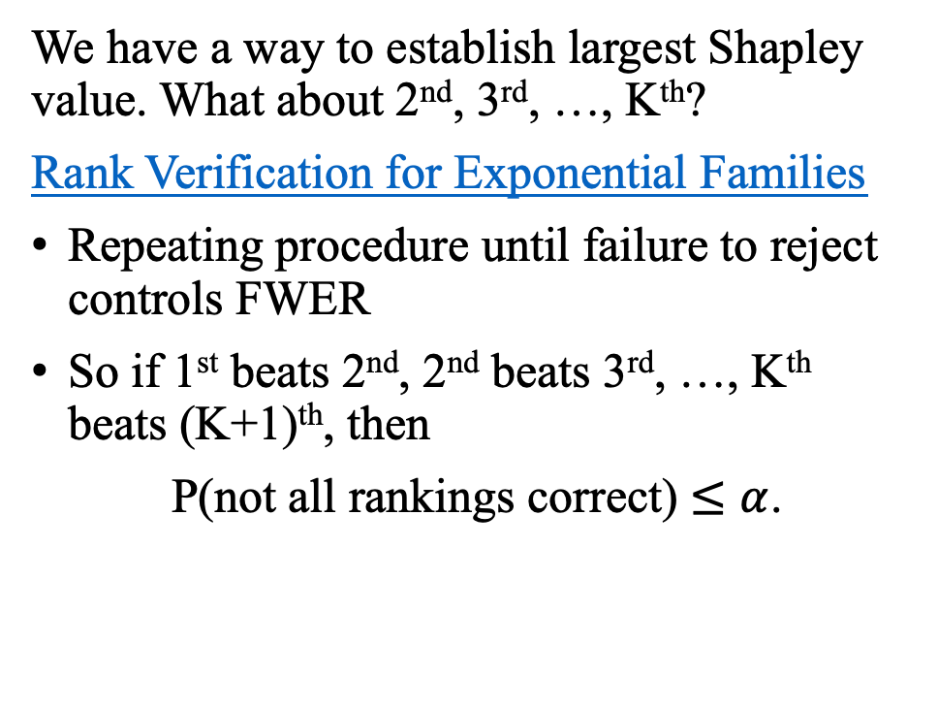
K Largest Shapley Values
We have a way to establish largest Shapley value. What about 2nd, 3rd, …, K^{th}?
Rank Verification for Exponential Families
Repeating procedure until failure to reject controls FWER
So if 1st beats 2nd, 2nd beats 3rd, …, K^{th} beats (K+1)^{th}, then
P(not all rankings correct) $≤α$.

Slide 27
RankSHAP Algorithm
For each feature:
Get initial Shapley Sampling estimate
While ≥ one of the K pairwise comparison tests fails to reject:
Estimate # samples needed for test to reject
Run Shapley Sampling on those features for that many samples

Slide 28
RankSHAP Algorithm
For each feature:
Get initial Shapely Sampling estimate
While ≥ one of the K pairwise comparison tests fails to reject:
Estimate # samples needed for test to reject
Run Shapley Sampling on those features for that many samples
Theorem: P(at least 1 top-K ranking error) ≤

Slide 29
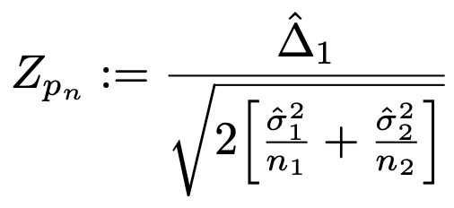
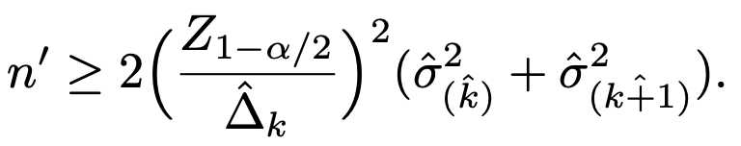
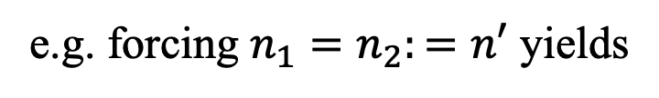
What if a test fails to reject?
We use the test statistic
Solve for $n_{1},n_{2}$ s.t. $Z_{p_{n}}≥Z_{1−α/2}$
e.g. forcing $n_{1}=n_{2}:=n′$ yields

Slide 30

Results

Slide 31
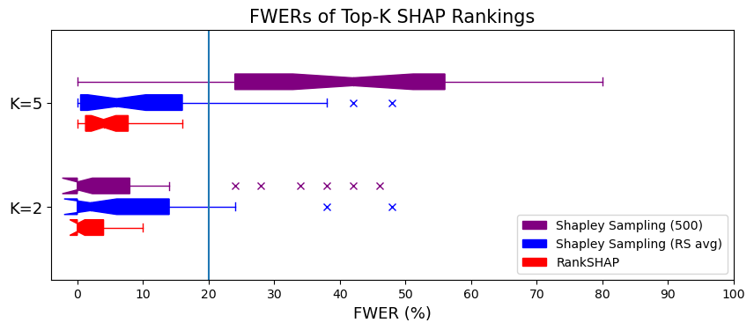

Slide 32
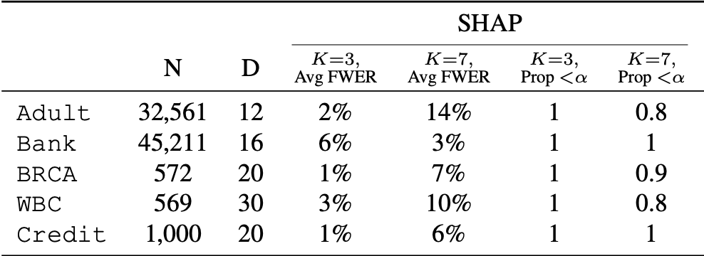

Slide 33
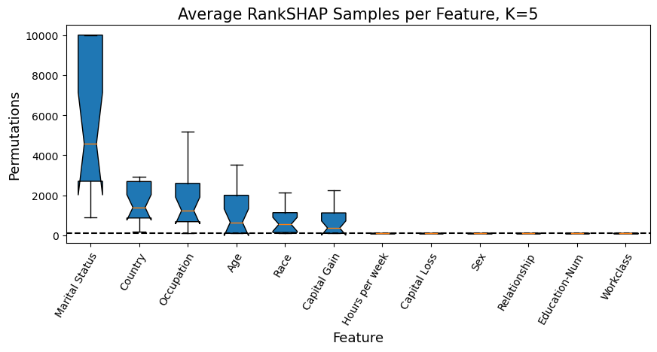

Slide 34
LIME

Slide 35
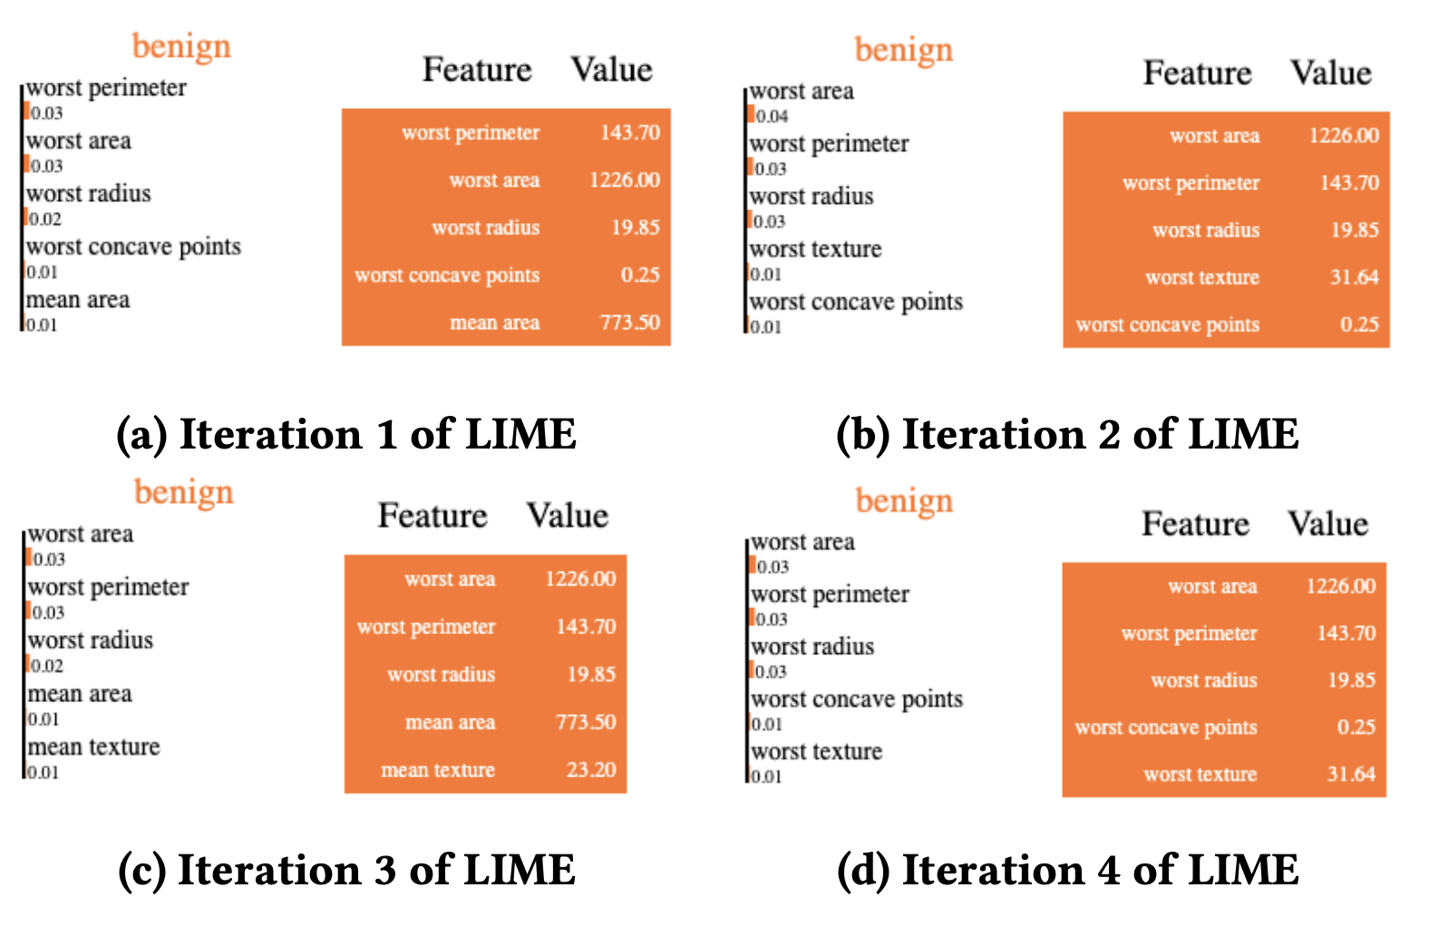
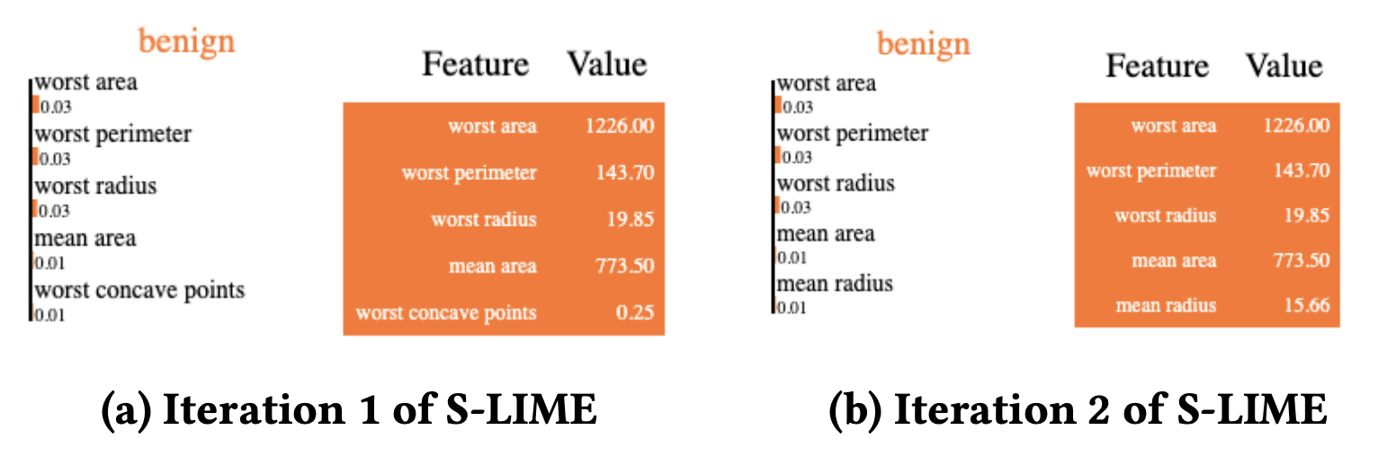
LIME & S-LIME
To explain an input, LIME fits an interpretable model on samples randomly generated around it
K-LASSO selects K features in order
At each step, S-LIME generates enough samples s.t. highest- “scoring” selection beats runner-up w.p. ≥ 1 -

Slide 36
LIME & S-LIME
To explain an input, LIME fits an interpretable model on samples randomly generated around it
K-LASSO selects K features in order
At each step, S-LIME generates enough samples s.t. highest- “scoring” selection beats runner-up w.p. ≥ 1 -
This does not control FWER!

Slide 37
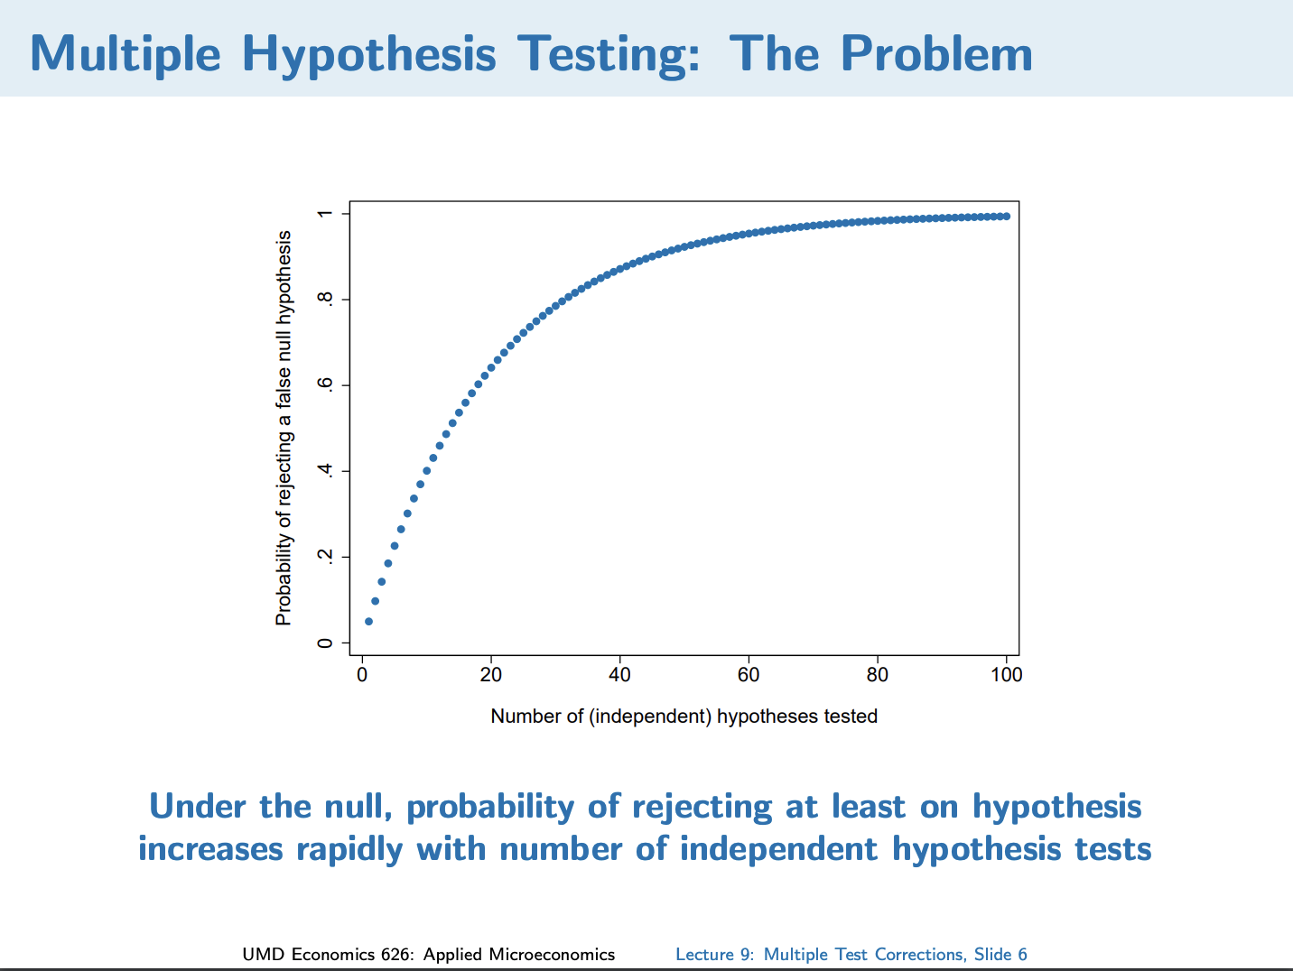

Slide 38

Bonferroni Correction
FWER = P(at least 1 false rejection)
Bonferroni lowers significance threshold by a factor of # tests

Slide 39
Bonferroni Correction
FWER = P(at least 1 false rejection)
Bonferroni lowers significance threshold by a factor of # tests
Running S-LIME w/ controls FWER = P(at least 1 incorrect ranking) ≤
Factor of 2 ensures selected feature beats all, not just runner-up

Slide 40
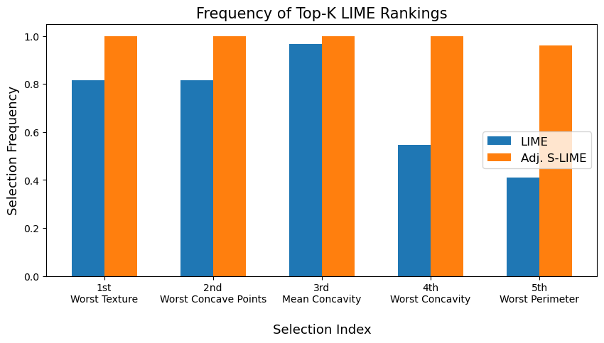

Slide 41
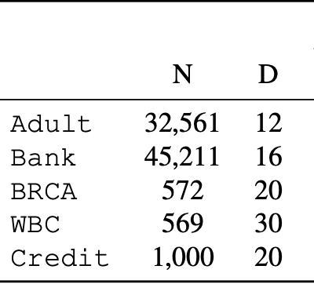
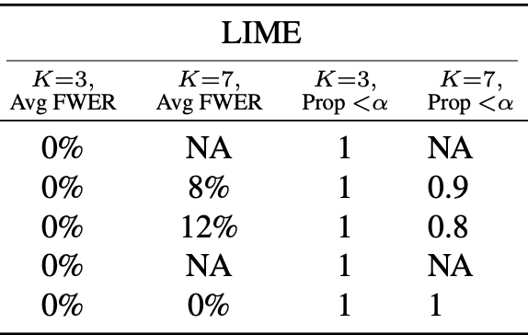

Slide 42

Stabilizing Estimates of Shapley Values with Control Variates

Slide 43
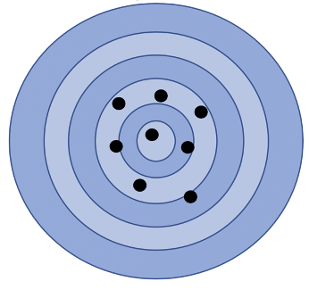

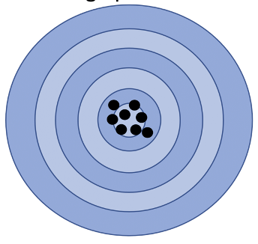
Control Variates
x
x

Slide 44
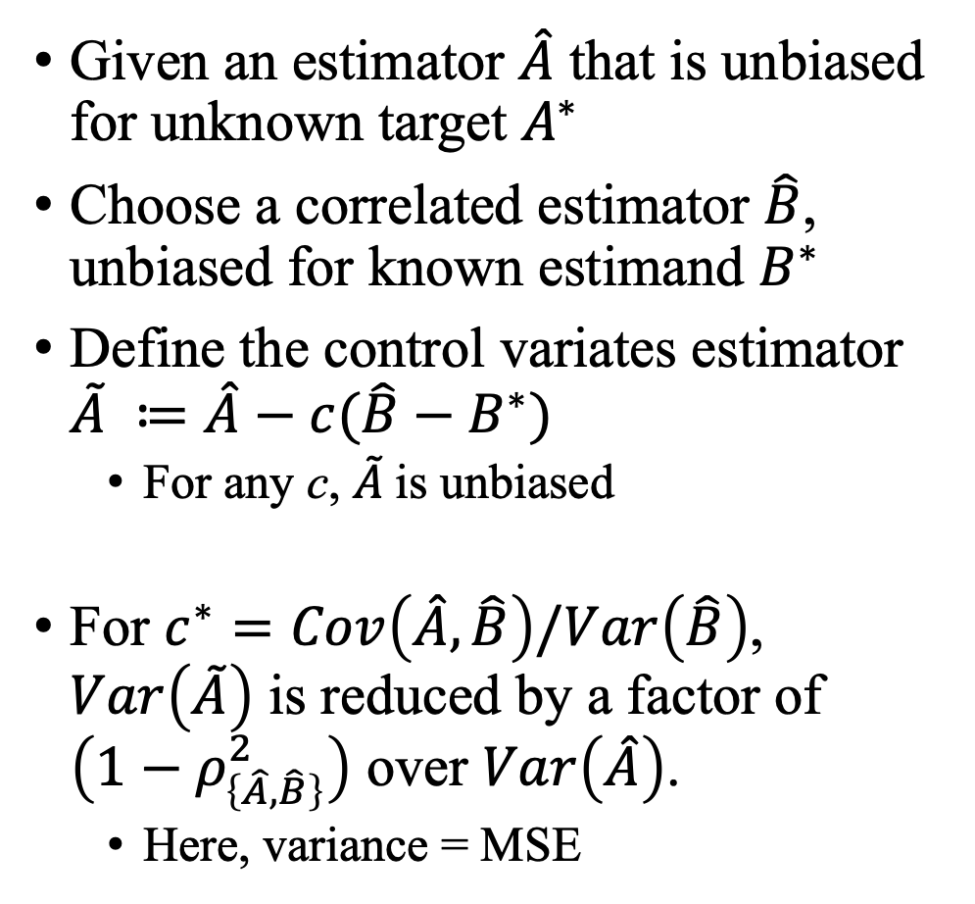
Control Variates
Given an estimator $\hat{A}$ that is unbiased for unknown target $A^{∗}$
Choose a correlated estimator $\hat{B}$, unbiased for known estimand $B^{∗}$
Define the control variates estimator $\tilde{A} ≔\hat{A}−c(\hat{B}−B^{∗})$
For any c, $\tilde{A}$is unbiased
For $c^{∗}=Cov\left(\hat{A},\hat{B}\right)/Var\left(\hat{B}\right)$, $Var\left(\tilde{A}\right)$ is reduced by a factor of $\left(1−ρ_{\left\{\hat{A},\hat{B}\right\}}^{2}\right)$ over $Var\left(\hat{A}\right)$.
Here, variance = MSE

Slide 45
Shapley Estimation
Shapley Value
Shapley Sampling Estimate
KernelSHAP Estimate

Slide 46
Constructing a Control Variate
SHAP value function
We need an estimator that 1) is positively correlated with the Shapley estimate, and 2) has known estimand
Each of the n samples indexes a random subset of features. The control variate will use these same subsets – but for a different predictor: the Taylor Expansion of f around x
What order expansion it is depends on how X_{–S}|X_{S} is sampled in the value function

Slide 47
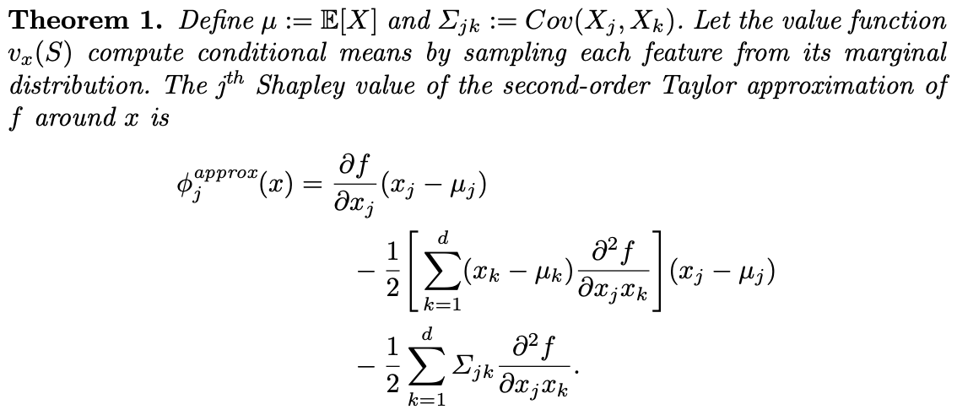
A Control Variate for the Shapley Value (1/2)

Slide 48
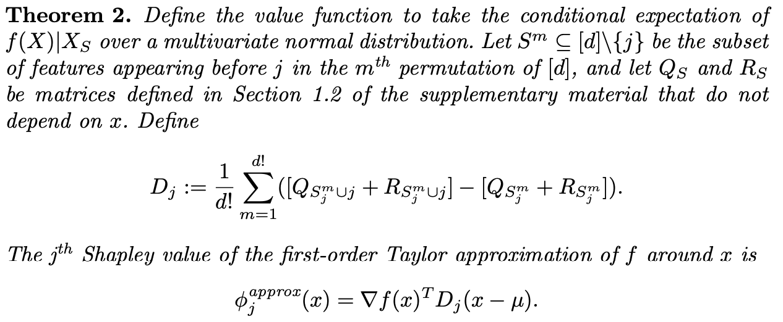
A Control Variate for the Shapley Value (2/2)

Slide 49
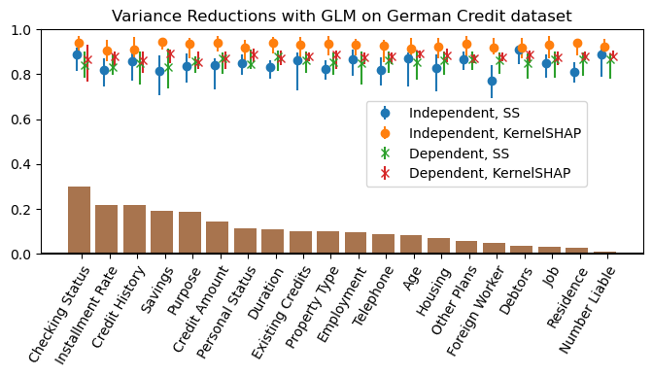

Slide 50
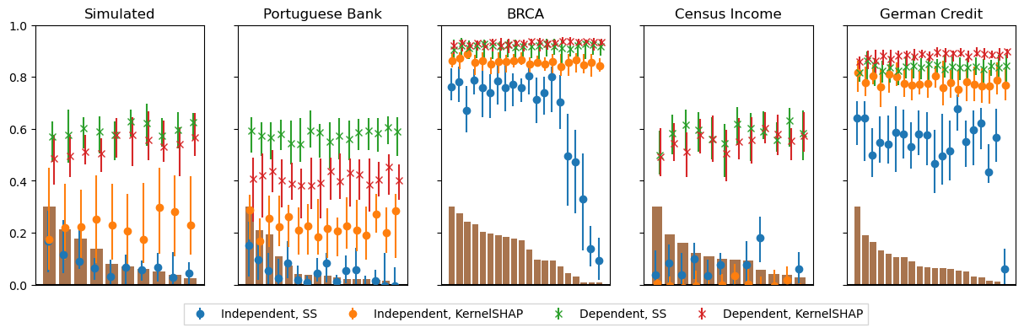
ControlSHAP Variance Reductions, Neural Net

Slide 51
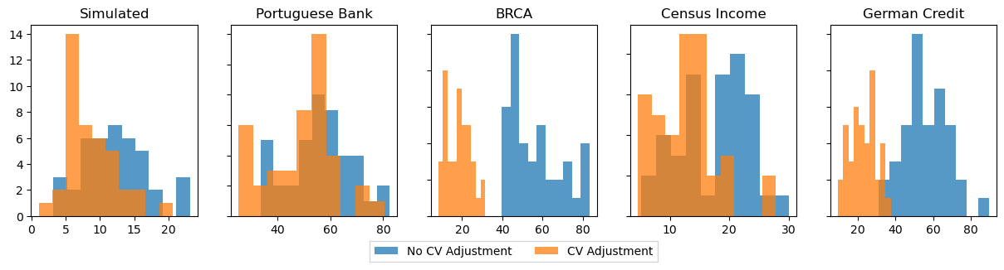
Importance Rankings More Stable

Slide 52

Conclusion
ML explanations must be trustworthy to be useful
Identify most important features with statistical guarantees for SHAP & LIME
Next Steps
Keep computational work with sequential testing
Local → Global Shapley feature importances

Slide 53

Thanks for your attention!

